Slide 1
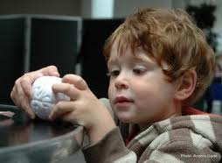
Frontal lobes, cognitive control and consciousness
Andy Wills

Slide 2
Scientific study of consciousness
Consciousness
Perception
Attention
Memory
Action
Blindsight
Meditation
Episodic
Frontal function
Normal awareness
Hallucinogens
Autonoetic
Drug addiction
Voluntary action
P- consciousness
A- consciousness

Slide 3
Key reference
Miller, E. K., & Cohen, J. D. (2001). An integrative theory of prefrontal cortex function. Annual Review of Neuroscience, 24 , 167-202.

Slide 4
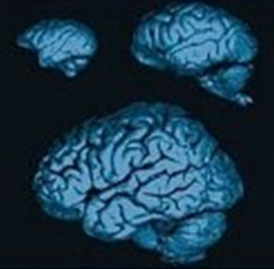
Big brains
Animals with fewer than 100k neurons can approach food and avoid predators.
What's the rest doing?
Presumably increased flexibility of behaviour
The PFC is the most elaborated in primates, which we might consider to be particularly flexible.
Although see also corvids?

Slide 5

What does flexibility mean?
What is fundamental to this behavioural flexibility?
The ability to select a weaker, task-relevant response in the face of competition from an otherwise stronger, but task-irrelevant one.
This is the kind of ability lost in frontal lobe damage.
WCST example (Milner, 1963)

Slide 6
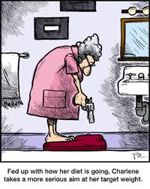
How does PFC promote flexibility?
Miller & Cohen’s (2001) theory - PFC is responsible for the active maintenance of patterns of activity that represent goals and the means to achieve them.
Acts through biasing…
sensory systems (where we call it attention)
motor systems (where we can it response selection and inhibitory control)
intermediate systems (support WM, guide LTM retrieval)
Without PFC, habitual responses win / disorganized behaviour. Both are characteristic of PFC damage (e.g. Duncan, 1986).

Slide 7
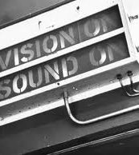
What does PFC need to do this?
Sensory input integration.
Many PFC areas receive converging inputs from at least two sensory modalities.
PFC also connected to multimodal convergence centres.

Slide 8
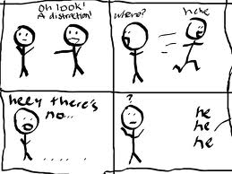
What does PFC need to do this?
Active maintenance.
PFC neurons stay active between cue presentation and response execution (Fuster, 1971).
But activity also persists for several seconds in e.g. cortical visual areas (Fuster & Jervey, 1981).
However, PFC is different in that it maintains in the face of interference - e.g. a delay filled with visual distractors (Miller et al., 1996).

Slide 9
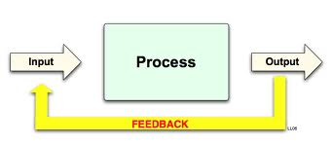
What does PFC need to do this?
Feedback.
PFC sends projections to much of the neocortex (Pandya & Yeterian, 1990).
De-activating PFC neurones reduces activity of IT and posterior parietal neurons to a behaviourally relevant cue.

Slide 10
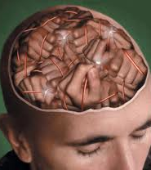
What does PFC need to do this?
Plasticity.
Modallly (44%), PFC neurons represent a combination of cue and response - they reflect learned associations (Asaad et al. 1998).
PFC neurons develop selectivity - FEF not ordinarily selective to form/colour become so when eye movements are contingent on this information (Bichot et al., 1996).
PFC neurones reflect whether monkeys are using a matching or non-matching rule (Wallis et al., 2000)

Slide 11

What does PFC need to do this?
Plasticity continued.
How does the system update?
DA midbrain reinforcement systems.

Slide 12
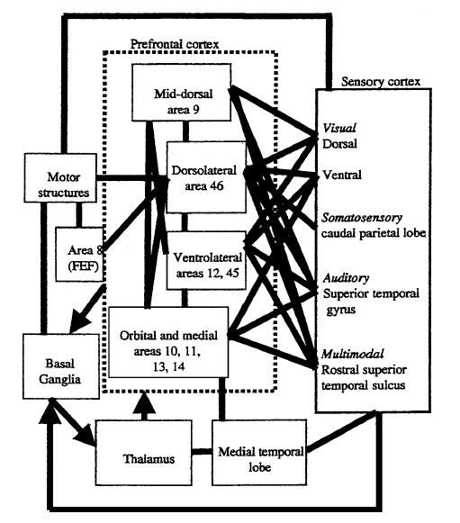
PFC machinery for goal maintenance

Slide 13
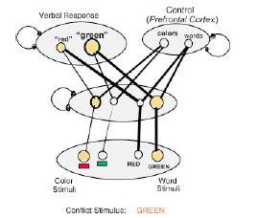
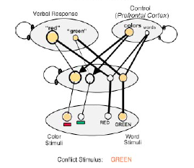
A simple(r) model of PFC

Slide 14
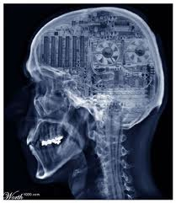
Implications for consciousness
PFC seems to be responsible for those things characteristic of (action) consciousness.
Implications for status as consciousness entity for:
Primates
Other vertebrates
Invertebrates
Frontal patients
Anyone under 30?

Slide 15
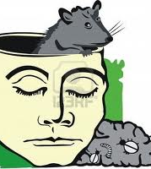
Implications for consciousness
It's a flexible control process, but it is turn is configured by simple reinforcement learning.
To what extent are goals, voluntarily willed free intentions?
Or the product of simple reinforcement history?

Slide 16
Drug addiction

Slide 17
Key Reference
Robinson, T. E. (2003). Addiction. Annual Review of Psychology, 54 , 25-53.

Slide 18
Nature of drug addiction
“compulsive pattern of drug-seeking and drug-taking behavior that takes place at the expense of most other activities”
Clear relation to intentional action / free will.
Drug exposure high (60%; 90% inc. alcohol)
Addiction (at least as defined above) rare (cocaine: 15% in 10yrs use)

Slide 19
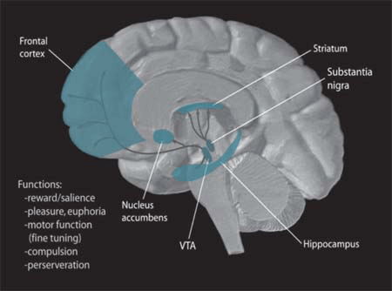
Brain systems
The basic neuroscience is well understood, and applies to most addictive drugs.
dopamine projections from the ventral tegmental area and substantia nigra to the nucleus accumbens(NAcc) and striatum, as well as glutamate inputs from the prefrontal cortex, amygdala and hippocampus.
In other words, central reward system.
Addictive drugs not only operate on but also change these pathways.
But what are the psychological effects?

Slide 20
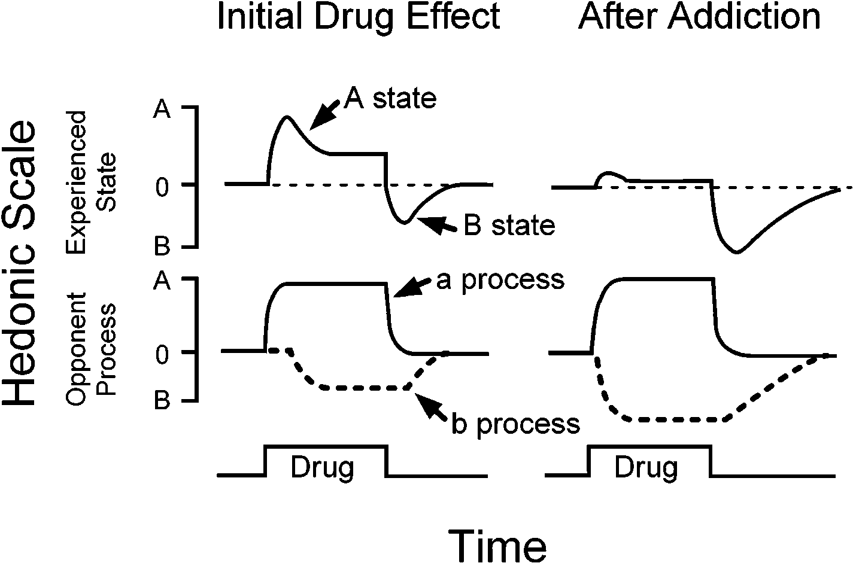
Tolerance and withdrawal symptoms
Drug taking is initially reinforced by the “highs”, but pharmacological tolerance sets in, and then drug taking is maintained by avoidance of the “lows”.
Formally, “opponent process” theory.
But the relation between withdrawal symptoms and recidivism is pretty weak (hence the relatively poor record of detox-based drug rehabilitation programmes).
Also some interesting animal studies considering a-process and b-process induction by drugs, and effects on relapse (turns out to be a rather than b).

Slide 21
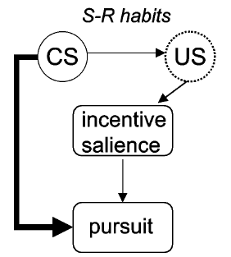
Goal versus Habit learning systems
Action-outcome (goal directed learning)
Stimulus-response (habitual learning)
Even with reinforcers such as food, or secondary reinforcement, repeated actions become habitual (hence “slips of action”).
Neuroscience indicates drugs of addiction powerfully activate reward systems in the S-R system (corticostriatal loops).
Good support from animal studies
Some (e.g. Robinson & Berridge) think it’s unlikely because many habitual behaviours do not appear to be “addictive” in the same sense as drug taking. A rather phenomenological argument.
One real paradox - drug-seeking behaviour in humans seems highly goal-directed and flexible.

Slide 22
Incentive sensitization: Compulsive “wanting”
“Wanting” (incentive motivation) and “liking” (reward systems) are dissociable.
Not all drug effects habituate (tolerance), some sensitive (increase).
Addictive drugs seem to cause psychomotor sensitization (e.g. Heightened locomotion, exploration, approach).
Psychomotor sensitization is context-specific (and hence seems to involve learning) – both in terms of generalization decrement, and the absolute novelty of the learning context.
Drug-induced sensitization leads rats to work harder for a reward, and increases incentive value of a reward (e.g. as measured by running speed)
Drug-related cues (in animal models) seem to do the same ie. Make them work harder for a reward.
Implication: Drug-related cues in humans produce excessive “wanting” of those drugs.
Animal models suggest this psychomotor sensitization can persist for years after drugs administration has stopped.
Psychomotor sensitization shows stark individual differences.
There may be cross-sensitization to other drugs. And to stress.

Slide 23
Frontal damage: “Blowing your brains out”
Chronic drug exposure depresses neural processing in frontal regions – both activity and, in polysubstance abuse – sometimes also volume.
Chronic drug users show a similar profile of deficits on cognitive tasks to those seen in patients with frontal lobe damage.
Frontal regions are involved in inhibitory control. Damage leads to difficulty in inhibiting prepotent responses.

Slide 24
That’s all folks!

